Slide 1

OBSTACLE AVOIDING ROBOT
BY,
BARANIDHARAN S
SANJEEV U
JEEVAN PRABAKARAN S
JUBINNATH R
MENTOR :
Dr.MAGESHWARAN.M, HOD of Mechatronics
ARUNKUMAR.S, Assistant Professor

Slide 2
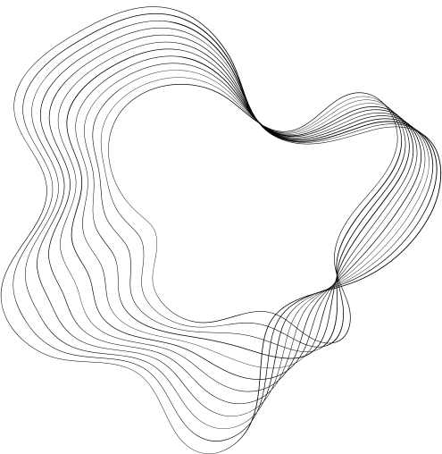
OBSTACLE AVOIDING ROBOT
An Obstacle Avoidance Robot is an intelligent robot, which can automatically sense and overcome obstacles on its path. It contains of a Microcontroller to process the data, and Ultrasonic sensors to detect the obstacles on its path.
Obstacle avoidance is one of the most important aspects of mobile robotics. Without it robot movement would be very restrictive and fragile (easily damaged or broken).
It ensures that the robot does n’t have to stop in front of an obstacle which allows robot to navigate smoothly in an unknown environment, avoiding collisions.

Slide 3
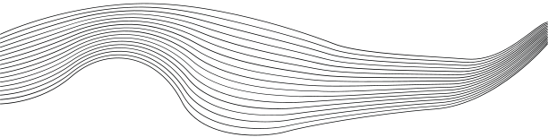
COMPONENTS REQUIRED
HARDWARE COMPONENTS
01
ARDUINO UNO
02
HC-SR04 ULTRASONIC SENSOR
SOFTWARE COMPONENTS
03
L293D MOTOR DRIVER MODULE
01
ARDUINO IDE
04
9V DC GEAR MOTORS
05
SERVO MOTOR
06
BATTERY
07
CHASSIS
08
JUMPER WIRES

Slide 4
ARDUINO NANO
Arduino UNO is a low-cost, flexible, and easy-to-use programmable open-source microcontroller board that can be integrated into a variety of electronic projects. This board can be interfaced with other Arduino boards, Arduino shields, Raspberry Pi boards and can control relays,buttons, motors, switches, LEDs, servos, and motors as an output.

Slide 5

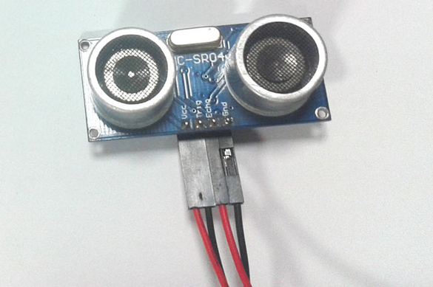
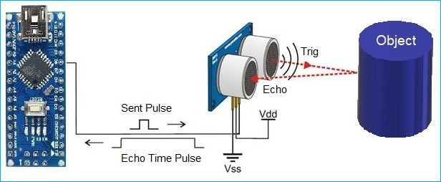

ULTRASONIC SENSOR (HC-SR04)
This sensor will have important role in detecting obstacle.
The basic principle behind the working of ultrasonic sensor is to note down the time taken by sensor to transmit ultrasonic beams
Receiving the ultrasonic beams after hitting the surface. Then further the distance is calculated using the formula.
Distance= (Time x Speed of Sound in Air)/2
d= (343 m/s)/2

Slide 6
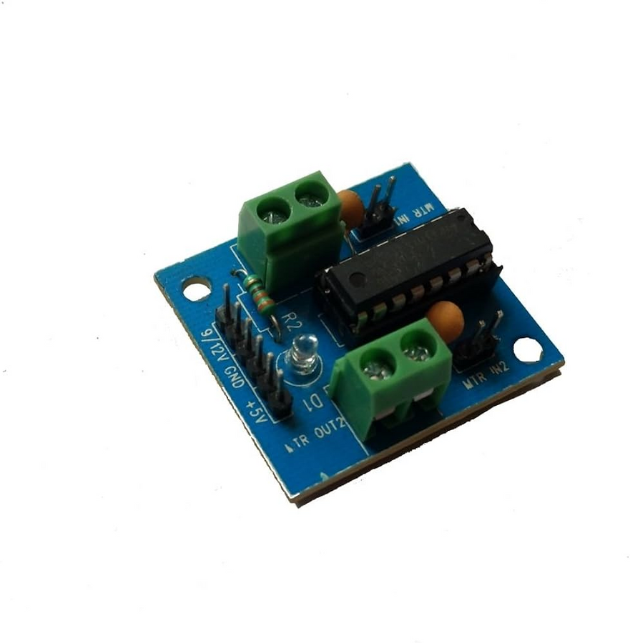
L293D-MOTOR DRIVER
THE L293D IS A 16-PIN MOTOR DRIVER IC WHICH CAN CONTROL A SET OF TWO DC MOTORS SIMULTANEOUSLY IN ANY DIRECTION. THE L293D IS DESIGNED TO PROVIDE BIDIRECTIONAL DRIVE CURRENTS OF UP TO 600 MA (PER CHANNEL) AT VOLTAGES FROM 4.5 V TO 36 V (AT PIN 8!). YOU CAN USE IT TO CONTROL SMALL DC MOTORS - TOY MOTORS.

Slide 7
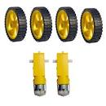
GEAR MOTOR
GEAR motors are electrical motors that convert direct current (DC) electrical energy into mechanical energy. DC motors can be subcategorized as brushed or brushless

Slide 8
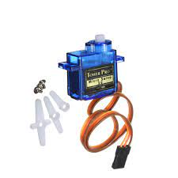
SERVO MOTOR
Servo motor - It turns left and right to the ultrasonic sensor or we can say that it helps the robot to sense obstacles in the left and right direction. Gear motor - It helps the robot to move in all directions (forward, backward, left, right). Wheels - It is connected to a gear motor

Slide 9
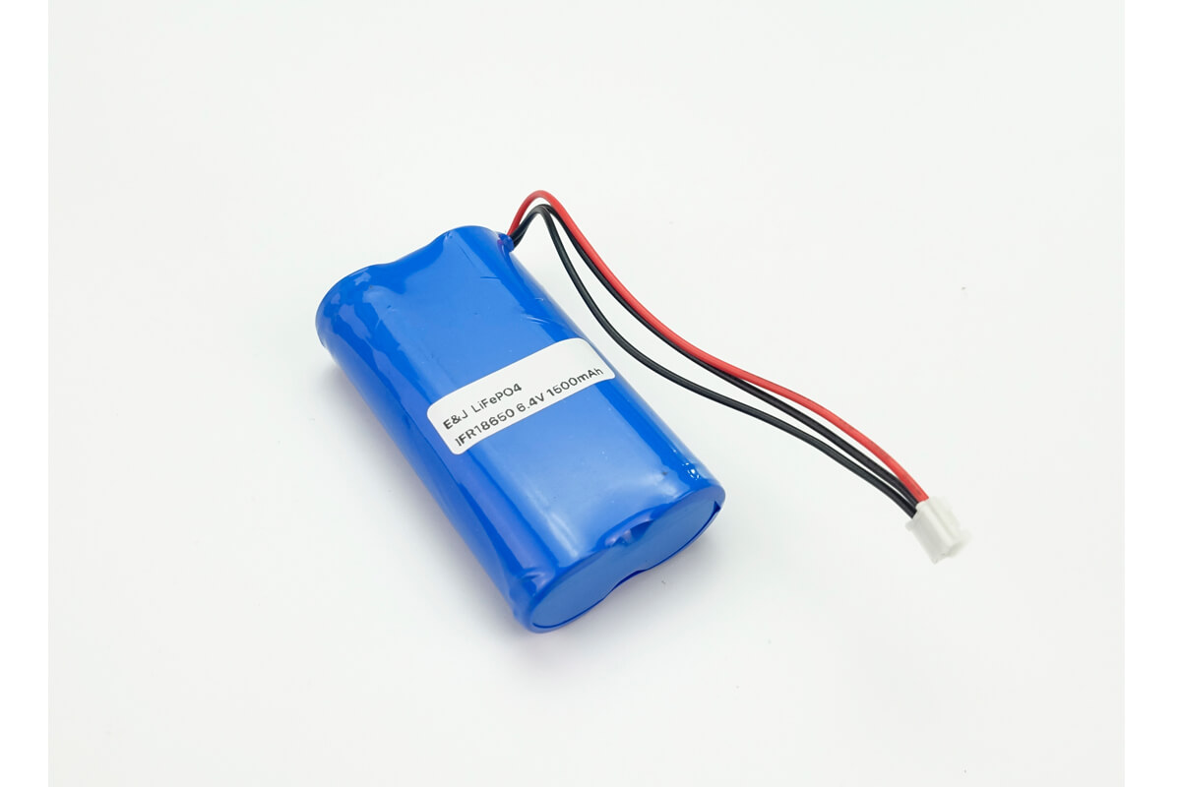
Li-ion battery
A lithium-ion battery is a type of rechargeable battery that is charged and discharged by lithium ions moving between the negative (anode) and positive (cathode) electrodes. take 2 3.7v battery and connect in serial it is converted into 7.4

Slide 10
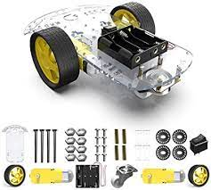
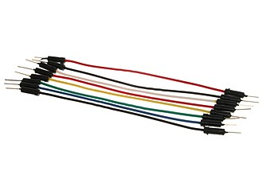
CHASSIS AND JUMPERS
A chassis is the load-bearing framework of a manufactured object, which structurally supports the object in its construction and function
A jumper wire is an electric wire that connects remote electric circuits used for printed circuit boards. By attaching a jumper wire on the circuit, it can be short-circuited and short-cut (jump) to the electric circuit.

Slide 11
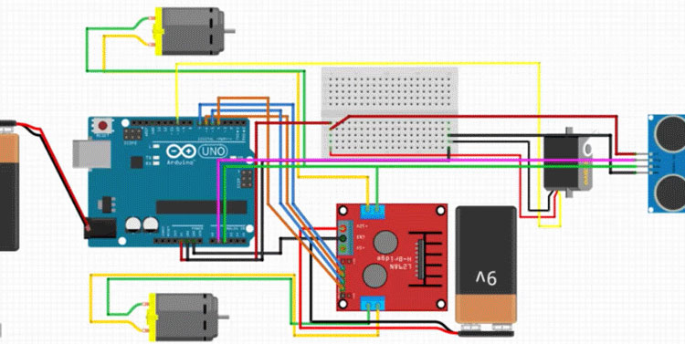
Circuit configure

Slide 12
WORKING PROCESS
The robot reads data from its sensors, such as ultrasonic or infrared sensors.
It processes the sensor data and calculates the distance to the nearest obstacle.
Based on the sensor data and obstacle distance, the robot's software decides on its next move, such as turning, stopping, or continuing forward.
The software sends motor control commands to the motor drivers, which drive the wheels accordingly.
The robot repeats this process continuously, effectively navigating around obstacles and avoiding collisions.
E ROBOT READS DATA FROM ITS SENSORS, SUCH AS ULTRASONIC OR INFRARED SENSORS.It processes the sensor data and calculates the distance to the nearest obstacle
Drew Holloway
Remy Marsh

Slide 13
CODES:
#include <Servo.h> //Servo motor library. This is standard library
#include <NewPing.h> //Ultrasonic sensor function library. You must install this library
//our L298N control pins
const int LeftMotorForward = 7;
const int LeftMotorBackward = 6;
const int RightMotorForward = 4;
const int RightMotorBackward = 5;
//sensor pins
#define trig_pin A1 //analog input 1
#define echo_pin A2 //analog input 2
#define maximum_distance 200
boolean goesForward = false;
int distance = 100;
NewPing sonar(trig_pin, echo_pin, maximum_distance); //sensor function
Servo servo_motor; //our servo name

Slide 14
void setup(){
pinMode(RightMotorForward, OUTPUT);
pinMode(LeftMotorForward, OUTPUT);
pinMode(LeftMotorBackward, OUTPUT);
pinMode(RightMotorBackward, OUTPUT);
servo_motor.attach(10); //our servo pin
servo_motor.write(115);
delay(2000);
distance = readPing();
delay(100);
distance = readPing();
delay(100);
distance = readPing();
delay(100);
distance = readPing();
delay(100);
}

Slide 15
void loop(){
int distanceRight = 0;
int distanceLeft = 0;
delay(50);
if (distance <= 20){
moveStop();
delay(300);
moveBackward();
delay(400);
moveStop();
delay(300);
distanceRight = lookRight();
delay(300);
distanceLeft = lookLeft();
delay(300);
if (distance >= distanceLeft){
turnRight();
moveStop();
}
else{
turnLeft();
moveStop();
}
}
else{
moveForward();
}

Slide 16
distance = readPing();
}
int lookRight(){
servo_motor.write(50);
delay(500);
int distance = readPing();
delay(100);
servo_motor.write(115);
return distance;
}
int lookLeft(){
servo_motor.write(170);
delay(500);
int distance = readPing();
delay(100);
servo_motor.write(115);
return distance;
delay(100);
}
int readPing(){
delay(70);
int cm = sonar.ping_cm();
if (cm==0){
cm=250;
}
return cm;
}

Slide 17
void moveStop(){
digitalWrite(RightMotorForward, LOW);
digitalWrite(LeftMotorForward, LOW);
digitalWrite(RightMotorBackward, LOW);
digitalWrite(LeftMotorBackward, LOW);}
void moveForward(){
if(!goesForward){
goesForward=true;
digitalWrite(LeftMotorForward, HIGH);
digitalWrite(RightMotorForward, HIGH);
digitalWrite(LeftMotorBackward, LOW);
digitalWrite(RightMotorBackward, LOW);
}
}
void moveBackward(){
goesForward=false;
digitalWrite(LeftMotorBackward, HIGH);
digitalWrite(RightMotorBackward, HIGH);
digitalWrite(LeftMotorForward, LOW);
digitalWrite(RightMotorForward, LOW);
}

Slide 18
void turnRight(){
digitalWrite(LeftMotorForward, HIGH);
digitalWrite(RightMotorBackward, HIGH);
digitalWrite(LeftMotorBackward, LOW);
digitalWrite(RightMotorForward, LOW);
delay(500);
digitalWrite(LeftMotorForward, HIGH);
digitalWrite(RightMotorForward, HIGH);
digitalWrite(LeftMotorBackward, LOW);
digitalWrite(RightMotorBackward, LOW);
}
void turnLeft(){
digitalWrite(LeftMotorBackward, HIGH);
digitalWrite(RightMotorForward, HIGH);
digitalWrite(LeftMotorForward, LOW);
digitalWrite(RightMotorBackward, LOW); delay(500);
digitalWrite(LeftMotorForward, HIGH);
digitalWrite(RightMotorForward, HIGH);
digitalWrite(LeftMotorBackward, LOW);
digitalWrite(RightMotorBackward, LOW);
}

Slide 19

ADVANTAGES AND USES:
1.An Obstacle Avoidance Robot is an intelligent robot, which can automatically
sense and overcome obstacles on its path.
2.It contains of a Microcontroller to process the data, and Ultrasonic sensors to detect the obstacles on its path.
3.Obstacle avoidance is one of the most important aspects of mobile robotics
APPLICATION:
1.Obstacle avoiding robots can be used in almost all mobile robot
navigation systems.
2.They can be used for household work like automatic vacuum cleaning
3.They can also be used in dangerous environments , where human
penetration could be fatal.

Slide 20
THANKING YOU..........
https://github.com/Baranidharan333/Obsticle-Avoidance.git

